Slide 1
Capstone Engagement
Assessment, Analysis, and Hardening of a Vulnerable System

Slide 2
Table of Contents
This document contains the following sections:
01
Network Topology
02
Red Team: Security Assessment
03
Blue Team: Log Analysis and Attack Characterization
Hardening: Proposed Alarms and Mitigation Strategies
04

Slide 3
Network Topology
‹#›

Slide 4
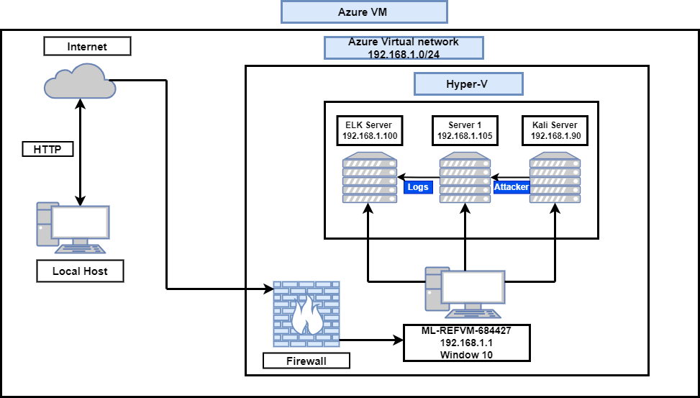
Network Topology
Network
IP Range:192.168.1.0/24
Netmask:255.255.255.0
Gateway: 192.168.1.1
Machines
IPv4:192.168.1.1
OS:Window 10 Pro
Hostname:ML-REFVM-684427
IPv4:192.168.1.90
OS:Kali Linux
Hostname:Kali
IPv4:192.168.1.105
OS:Linux
Hostname:Server1
IPv4:192.168.1.100
OS:Linux
Hostname:ELK

Slide 5

Red Team
Security Assessment
‹#›

Slide 6
Recon: Describing the Target
Nmap identified the following hosts on the network:
Hostname | IP Address | Role on Network
ML-REFVM-684427 | 7192..168.1.1 | Hyper-V Host Machine hosting Kali, Capstone & ELK
ELK | 192.168.1.100 | SIEM Machine with ELK stack (network logs from Server1 & Kali)
Server 1 (Capstone) | 192.168.1.105 | Target machine
Kali | 192.168.1.90 | Attacking Machine

Slide 7
Vulnerability Assessment
The assessment uncovered the following critical vulnerabilities in the target:
Vulnerability | Description | Impact
Use the CVE number if it exists. Otherwise, use the common name. | Describe the vulnerability. | Describe what this vulnerability allows the attacker to do.
Hydra Brute Force | Brute Force password by using a wordlists to match the password to the target user. | Hydra Brute Force tool gives the attacker the ability to access the Webdav directory.
Remote file upload | Uploading the PHP file into the target machine by using curl command line tool. | The attacker is able to remotely upload a malicious file to the webdav directory.
PHP Reverse Shell Code | Allow remote shell access | The attacker gained a remote access to the host machine and its content.

Slide 8
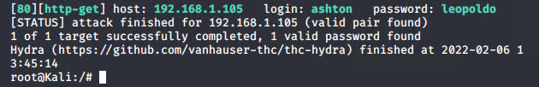
Exploitation: Hydra Brute Force
01
02
Tools & Processes
I was running the login name (ashton), against possible passwords options from the wordlists, with brute force tool called hydra
Achievements
I was able to find the password that matches the login name, which gained me access to the webdav directory.
03
hydra -l ashton -P /usr/share/wordlists/rockyou.txt -s 80 -f 192.168.1.105 http-get
http://192.168.1.105/company_folders/secret_folder

Slide 9
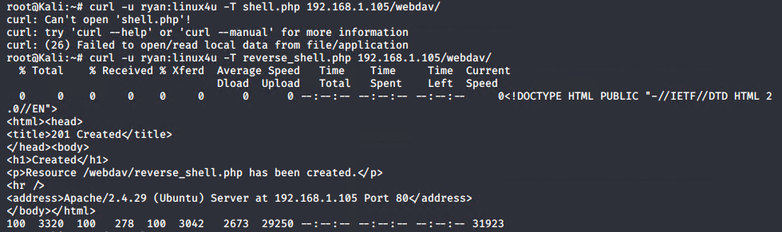
Exploitation: Remote File Upload
01
02
Tools & Processes
I was able to upload a malicious file in order to connect to the server remotely, by using a curl command-line tool to transfer the file.
Achievements
Using the curl command line allowed me to upload a malicious file in order to gain access to the webdav directory, and its files.
03

Slide 10
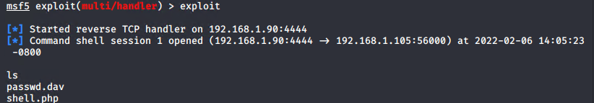
Exploitation: PHP Reverse Shell
01
02
Tools & Processes
After gaining access to webdav directory, and uploading a malicious file, the user then will click on the infected file, and by doing so will open a remote shell. The tool used was metasploit, with multi/handler.
Achievements
This allowed me a remote shell access to the server, and any content it contains at my disposal.
03

Slide 11

Blue Team
Log Analysis and Attack Characterization
‹#›

Slide 12
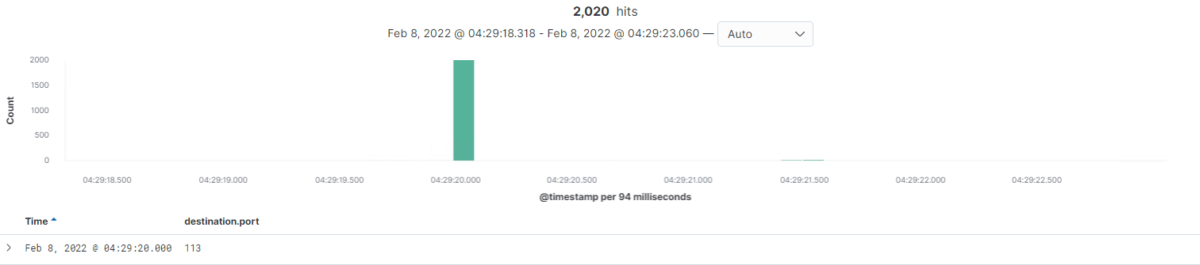
Analysis: Identifying the Port Scan
What time did the port scan occur?
Feb/08/2022 at 04:29:20
How many packets were sent, and from which IP?
There were 2020 packets sent from ip:192.168.1.90
What indicates that this was a port scan?
There were many different port scan within the packet logs.

Slide 13
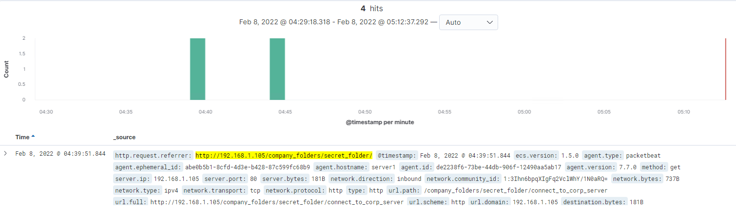
Analysis: Finding the Request for the Hidden Directory
What time did the request occur? The request was made on Feb/8/2022 at 04:39:12
How many requests were made? There were four requests made to the hidden directory.
Which files were requested? What did they contain?
The file requested was company_folders/secret_folder/connect_to_port_server. The file contained information log in to the company’s remote server.

Slide 14
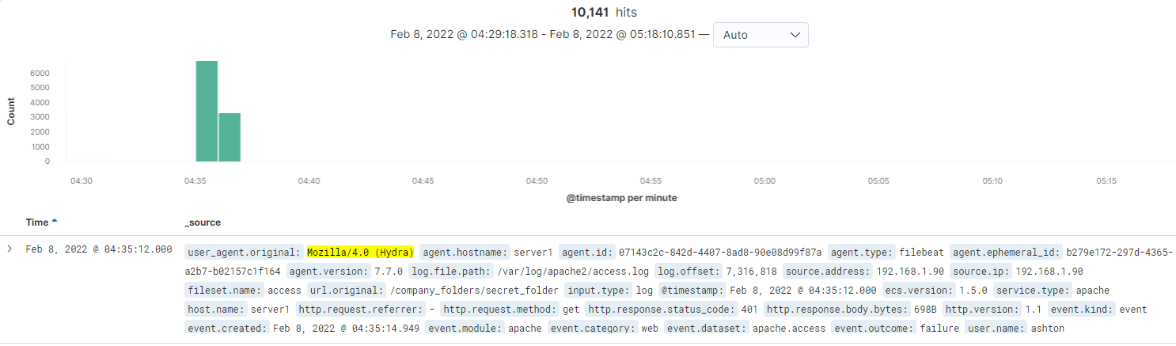
Analysis: Uncovering the Brute Force Attack
How many requests were made in the attack?
There were 10,141 requests made
How many requests had been made before the attacker discovered the password?
There were 10,140 requests made before the password was discovered for user:ashton

Slide 15
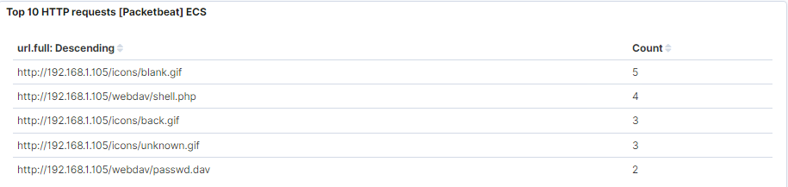
Analysis: Finding the WebDAV Connection
How many requests were made to this directory?
There were 6 requests made to the Webdav directory.
Which files were requested?
The files requested are: passwd.dav(2 requests) and shell.php (4 requests).

Slide 16
Blue Team
Proposed Alarms and Mitigation Strategies
‹#›

Slide 17
Mitigation: Blocking the Port Scan
What kind of alarm can be set to detect future port scans?
I will set an alarm to send an email that will be triggered if there are 5 events in an hour from any ip address.
What threshold would you set to activate this alarm?
The alarm threshold will be set at 5 events that will trigger an alarm that will be sent to a designated email.
What configurations can be set on the host to mitigate port scans?
Block all port scan.
Describe the solution. If possible, provide required command lines.
Configure the firewall to block any port scan.

Slide 18
Mitigation: Finding the Request for the Hidden Directory
What kind of alarm can be set to detect future unauthorized access?
I will send an email that will be triggered when any user accessed the hidden directory from any ip address that is not whitelisted.
What threshold would you set to activate this alarm?
I will sent an alarm with any event greater than 0.
What configuration can be set on the host to block unwanted access?
Password must contain letter, numbers, and characters, and should be minimum of 8 characters long.
Describe the solution. If possible, provide required command lines.
Use a strong password for admins. Make sure that the number of people that know about the secret folder is very limited, and change the name from secret folder to

Slide 19
Mitigation: Preventing Brute Force Attacks
What kind of alarm can be set to detect future brute force attacks?
I would set the alarm to send an email, that will be triggered when a predetermined number of failed logins accrued in one hour.
What threshold would you set to activate this alarm?
The threshold for this alarm will be 5 or more failed logins events in one hour.
What configuration can be set on the host to block brute force attacks?
I will configure the user accounts to lock after several failed logins attempts.
Describe the solution. If possible, provide the required command line(s).
The account will be locked after 5 failed logins attempts.

Slide 20
Mitigation: Detecting the WebDAV Connection
What kind of alarm can be set to detect future access to this directory?
I will set an alarm that will send an email when a user has accessed the Webdav directory from an ip address that is not whitelisted.
What threshold would you set to activate this alarm?
I will sent an alarm with any event greater than 5 in an hour.
What configuration can be set on the host to control access?
I will require multi factor authentication.
Describe the solution. If possible, provide the required command line(s).
The solution will require the user (real user) to confirm themselves through different methods of authentication such as email, or any outside source.

Slide 21
Mitigation: Identifying Reverse Shell Uploads
What kind of alarm can be set to detect future file uploads?
I will set an alarm to send an email, indicating that uploads were made to the webdav directory.
What threshold would you set to activate this alarm?
The threshold would be any event greater than 0.
What configuration can be set on the host to block file uploads?
I will configure the firewall rule to block any http request outside the ip whitelist.
Describe the solution. If possible, provide the required command line.
This will allow only authorized users to upload/modify anything in the webdav directory.

